Slide 1
COMPENSATION

Slide 2
POINT TO DISCUSS
What does it means?
Why it is important to discuss?
Types of compensation

Slide 3
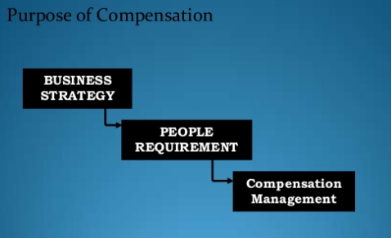
Meaning
According to Fisher (2004) “ money / goods/ services the employer gives to employees constitute compensation system.

Slide 4
It is important to discuss
Social Security is a monetary assistance from the state for people with an inadequate or non income.
Manager :
He use it
Influence employee behaviours
Attitude towards customers
Willingness to flexible.
Improve the organisational performance innovation

Slide 5
So according to Thomas(1988)
COMPENSATION SYSTEM
INDIRECT COMPENSATION
DIRECT COMPENSATION
Protection Programs:
Medical Insurance
Life insurance
Disability income
Pension
Social security
Pay for time not worked:
Vacations
Holidays
Sick leave
Jury duty
Services and perquisites:
Recreational
Car
Financial planning
Low-cost or free meals
Base Pay
Merit pay
salary
wage
Incentive pay
Bonus
Commission
Piece rate
Profit sharing
Stock option
Shift pay
Deferred pay
Savings plan
Annuity

Slide 6
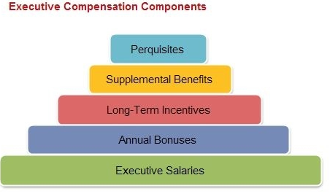
Executive Compensation
An executive typically is someone in the top two levels of an organization, such as Chief Executive Officer (CEO), President, or Senior Vice-President.

Slide 7
WAGE

Slide 8
Wages
A wage is monetary compensation (or remuneration) paid by an employer to an employee in exchange for work done.
Payment may be calculated as a fixed amount for each task completed piece rate, or at an hourly or daily rate.

Slide 9
Difference between Wage and Salary
The person receiving a salary is not paid a smaller amount for working fewer hours, nor is he paid more for working overtime.
Someone who is paid wages receives a pay rate per hour, multiplied by the number of hours worked.

Slide 10
Components of Wage and Salary
Basic Pay | base salary is a fixed amount of money paid to an employee by an employer in return for work performed.
Bonus | it a sum of money granted or given to an employee, a returned in addition to regular pay.
Dearness Allowance | The Dearness Allowance (DA) is a cost of living adjustment allowance paid to Government employees, Public sector employees (PSU) .
House Rent Allowance | House Rent Allowance is given by the employer to the employee to meet the expenses in connection with rent of the accommodation which the employee might have to take.
CCA | purpose of compensating them for the increased cost of living of big cities.
Fixed Medical Allowance | It is paid regularly at a fixed rate irrespective of the actual expenditure on medical treatment. It is fully taxable.
Conveyance Allowance | allowance which is granted to meet the expenditure on conveyance in performance of duties of an office .
CEA | allowance which is granted to an employee to meet the cost of education (including hostel allowance).
Fringe benefit | These include such motley crowd of employee benefit as PF, gratuity, medical care, hospitalization, accident relief, health and group insurance, canteen, uniform, recreation.
Perquisites | These are allowed to executive and include company car, club membership, paid holidays, furnished house, stock option scheme.

Slide 11
Types of Wages
Minimum wage | A minimum wage is the lowest hourly, daily or monthly remuneration that employers may legally pay to workers to increases the SOL, reduce poverty, boosts morale and forces businesses to be more efficient.
Fair wage | The lower limit of the fair wage must obviously be the minimum wage, the upper limit is the capacity of the industry to pay fair wage compares reasonably with the average payment of similar task in other trades or occupations requiring the same amount of ability.
Living wage | Thus living wages means the provision for the bare necessities plus certain amenities considered necessary for the wellbeing of the workers in terms of his social status.

Slide 12
Wages Differentials
Wage differential refers to differences in wage rates due to:
working conditions
type of product manufactured
location of company
hours of work
different skills working in the same industry
workers with similar skills working in different industries or regions.

Slide 13
types of wage differentials
Inter-Industry Differential | arise when workers in the same occupation and the same area but in different industries are paid different wages.
Inter-Personal Differentials | arise because of differences in the personal characteristics (age or gender) of workers who work in the same plant and the same occupation.
Inter-Occupational Differentials | wage differentials generally follow the changes in the relative supplies of labor to various occupations due general skill differentials. (white and blue collar)
Inter-Area Differentials | result of living and working conditions, such as unsatisfactory or isolation, disparities in the cost of living and the availability of manpower.
Inter-Firm Differentials | It reflect the differences in wage of workers in different plants in the same area and occupation.

Slide 14
Theories of wages
1.Subsistence Theory | also known as the "Iron Law of Wage.” wages are tend to maintain the level just significant to maintain the workers at the minimum subsistence.
2.Wage fund theory | Adam Smith. a predetermined “fund” for the payment of wages. wage could be determined simply by dividing the value of this fund by the number of workers.
3.Marginal Productivity theory | Philips Hennery (England) and John Bates Clark. wages are paid at a level equal to the marginal revenue product of labor. The marginal revenue product (MRP) of a worker - MRP = MP * MR. workers will be hired up to the point when the marginal revenue product is equal to the wage rate. if marginal revenue brought by the worker is less than the wage rate, then employing that laborer would cause a decrease in profit.
4.Residual Claimant theory | Walker. Wages represent the amount of value created in the production, which remains after payment has been made for all these factors of production.

Slide 15
Theories of wages
5.Barraging theory | wages are determined by the relative bargaining power of workers or trade unions and employers.
6.Employment theory | It is based on the interrelation between wages and employment. unemployment would disappear if workers were to accept a voluntary cut in wages.
7. Competitive theory | stress in wage determinations is demand and supply.

Slide 16
Wage law in India

Slide 17
Wage law
It is a body of law, administrative rulings which address the relationship between and among employer, employee and labor organizations.
It harmonies the relationship between employer, employee and trade union.
It evolves in India to response the specific needs of situation to suit requirements of planned “ economic development and social justice’.

Slide 18
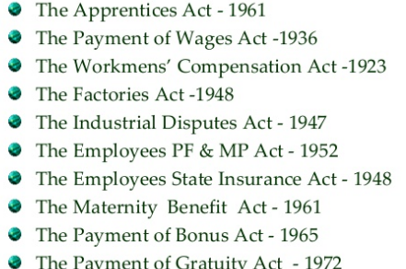
Acts of Labour Law

